Slide 1
Brew Master

Slide 2
Fun Facts about N.C. and Beer
North Carolina has over 100 Breweries
House 3 of the Nations Larges Brewiew
Oskar Blues
Sierra Nevada
New Belgium
Considered the best brew state south of the Mason-Dixon
Host the most favorable beer laws in the South East
Allows on of the highest Alcoholic Beverage Volumes for Malt Beverages (15%)

Slide 3
Brewery Locator Application
Entertainment purposes
Interactive Brewer Location
Power to locate local breweries at the tip of your fingers
Launch the Application from your desktop or mobile device
Return local Breweries searched
View details about the Breweries
Option to save to ”Favorites List”

Slide 4
User Story
AS AN Avid beer drinker
I WANT To be able to see a variety of local Breweries within the state of North Carolina
SO THAT I can make plans to visit the desired Breweries
GIVEN A Brewery App with user input
WHEN I search for a Brewery
THEN I am presented with the Brewery’s address
WHEN I view the Brewery information returned
THEN I am presented with the option to add the return to my favorities

Slide 5
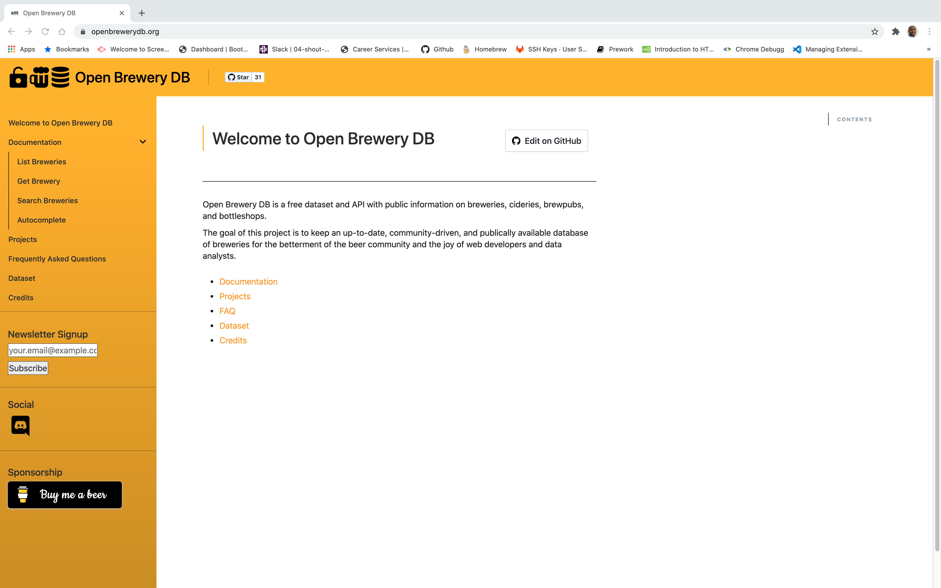
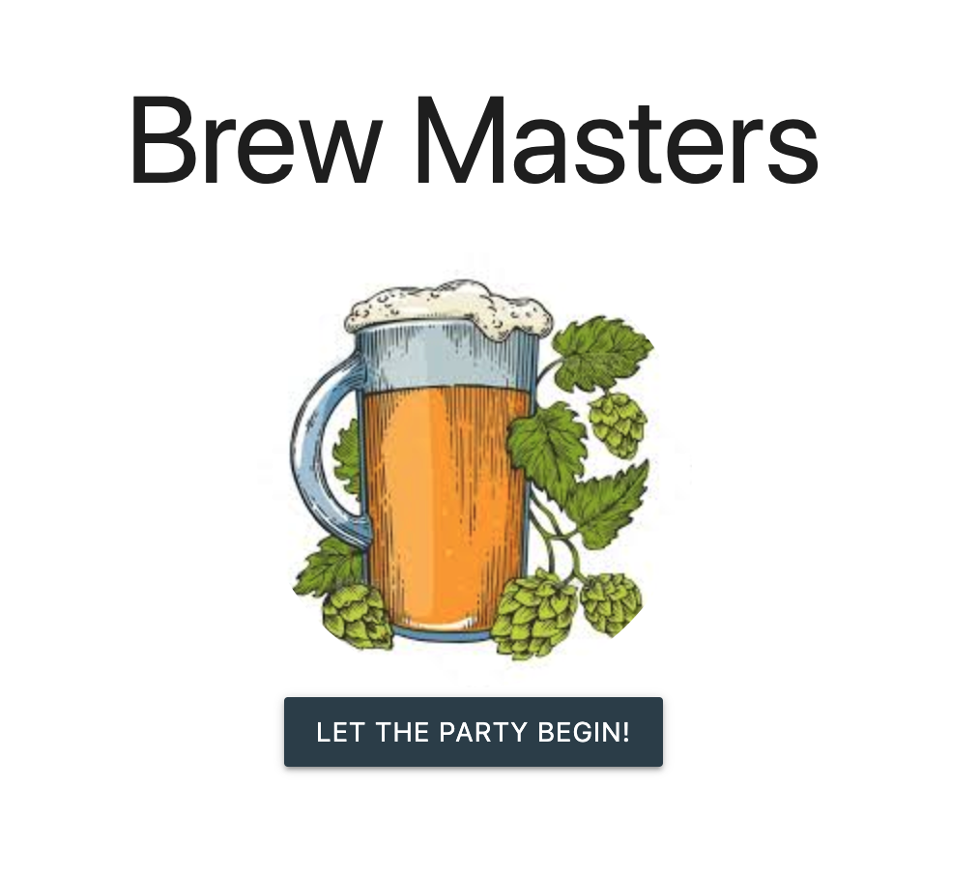
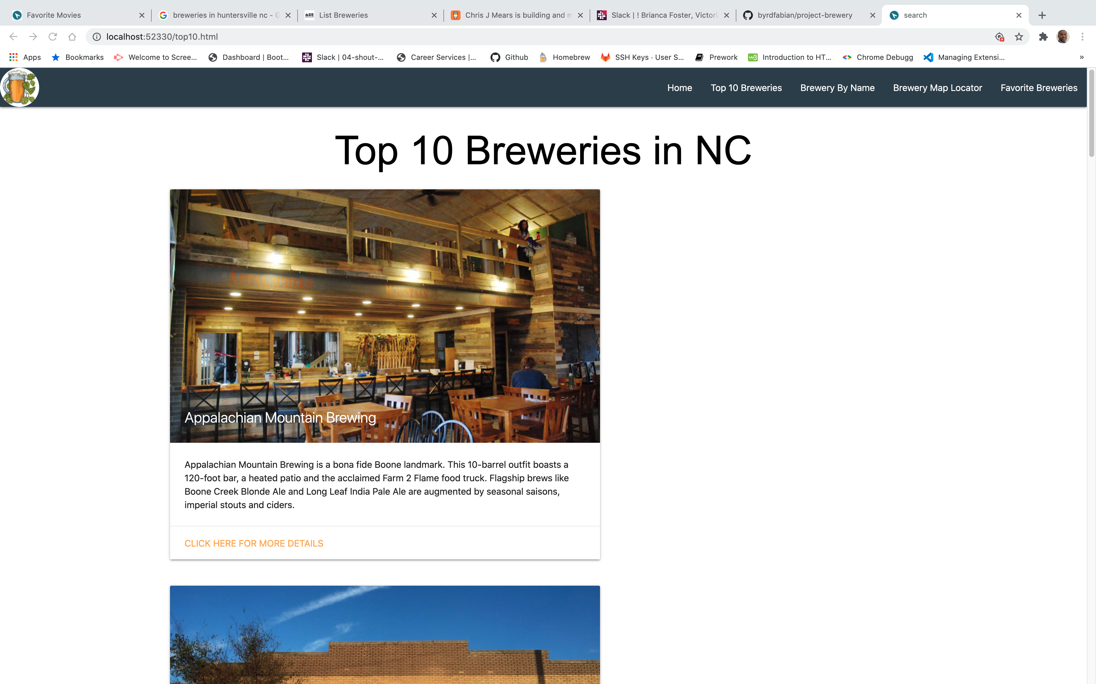
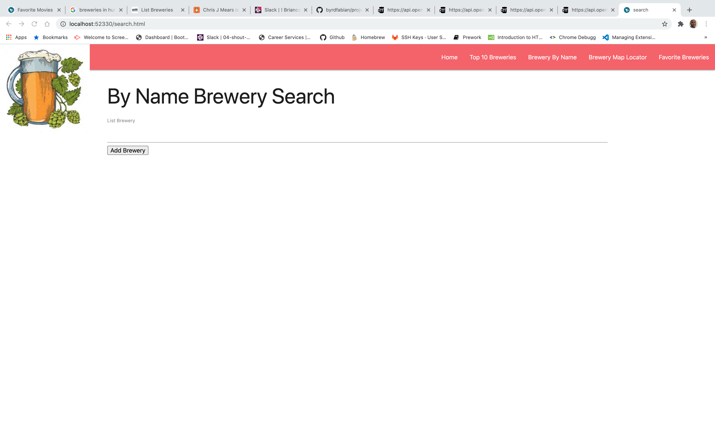
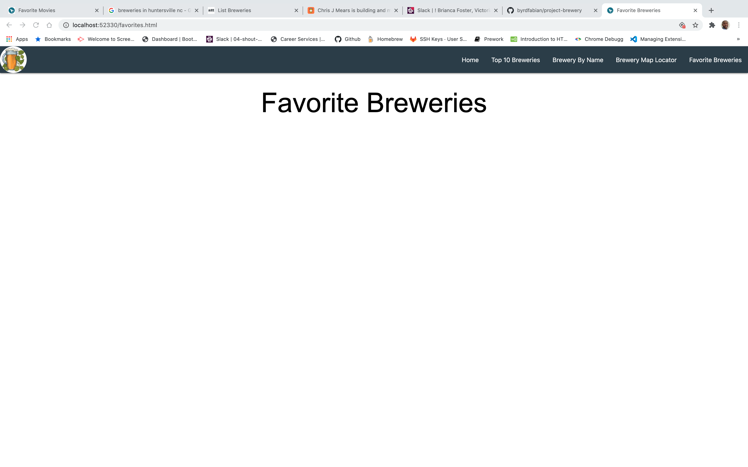
Wireframe Design
Home
Openbrewerdb.org
Top 10 Breweries
Brewery by Name
Favorite Breweries

Slide 6
APIs Used
PositionStack
OpenBreweryDB
Geolocation API

Slide 7
Demo
https://byrdfabian.github.io/project-brewery/

Slide 8
Rough Breakdown of Task
Victoria
Home
Favorite Breweries
HTML
CSS
JavaScript
Inspector of the Code
Brianca
Home
Top 10 Breweries
HTML
CSS
JavaScript
Fabian
Home
Brewer by Name
HTML
CSS
JavaScript

Slide 9
Questions

